Slide 1
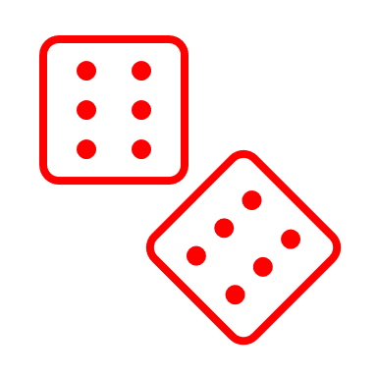
Sight Word Game Board
Finish
is
Do 10 jumping
jacks
at
the
with
him
Ball Sight Word Lists
Baseball | Soccer Ball | Basketball | Football | Volleyball | Golf Ball | Tennis Ball | Bowling | Ping Pong | Hockey Puck | Beach Ball
the | at | do | big | from | away | walk | tell | soon | use | wash
to | him | can | went | good | old | two | much | made | fast | show
and | with | would | are | any | by | round | keep | run | say | hot
he | little | did | come | about | their | before | give | gave | light | because
a | some | when | if | around | here | eat | work | open | pick | best
I | look | what | now | want | saw | again | first | has | hurt | live
you | is | so | long | don't | call | play | try | find | pull | draw
it | her | see | no | how | after | who | new | only | cut | clean
of | have | were | came | know | well | been | must | us | kind | grow
in | all | not | ask | right | think | may | start | three | both | shall
was | out | get | very | put | ran | stop | black | our | sit | upon
said | as | them | an | too | let | off | white | better | which | these
his | be | like | over | got | help | never | ten | hold | fall | sing
that | there | this | your | take | make | seven | does | buy | carry | together
she | down | one | its | four | going | eight | bring | funny | small | please
for | we | my | ride | every | sleep | cold | goes | warm | under | thank
on | am | could | into | pretty | brown | today | write | ate | read | wish
they | then | me | just | jump | yellow | fly | always | full | why | many
but | up | yes | blue | green | five | myself | drink | those | own | far
had | go | will | red | where | six | or | once | done | found | laugh
and
they
but
had
the
be
Do 10 jumping
jacks
have
on
Roll the dice, read the word!
for
she
Move back 2 spaces
his
said
was
that
in
of
the
to
and
he
Move ahead 2 spaces
you
it
Start

Slide 2
Sight Word Game Board
Finish
Ball Sight Word Lists
Baseball | Soccer Ball | Basketball | Football | Volleyball | Golf Ball | Tennis Ball | Bowling | Ping Pong | Hockey Puck | Beach Ball
the | at | do | big | from | away | walk | tell | soon | use | wash
to | him | can | went | good | old | two | much | made | fast | show
and | with | would | are | any | by | round | keep | run | say | hot
he | little | did | come | about | their | before | give | gave | light | because
a | some | when | if | around | here | eat | work | open | pick | best
I | look | what | now | want | saw | again | first | has | hurt | live
you | is | so | long | don't | call | play | try | find | pull | draw
it | her | see | no | how | after | who | new | only | cut | clean
of | have | were | came | know | well | been | must | us | kind | grow
in | all | not | ask | right | think | may | start | three | both | shall
was | out | get | very | put | ran | stop | black | our | sit | upon
said | as | them | an | too | let | off | white | better | which | these
his | be | like | over | got | help | never | ten | hold | fall | sing
that | there | this | your | take | make | seven | does | buy | carry | together
she | down | one | its | four | going | eight | bring | funny | small | please
for | we | my | ride | every | sleep | cold | goes | warm | under | thank
on | am | could | into | pretty | brown | today | write | ate | read | wish
they | then | me | just | jump | yellow | fly | always | full | why | many
but | up | yes | blue | green | five | myself | drink | those | own | far
had | go | will | red | where | six | or | once | done | found | laugh
Roll the dice, read the word!
Start

