Slide 1
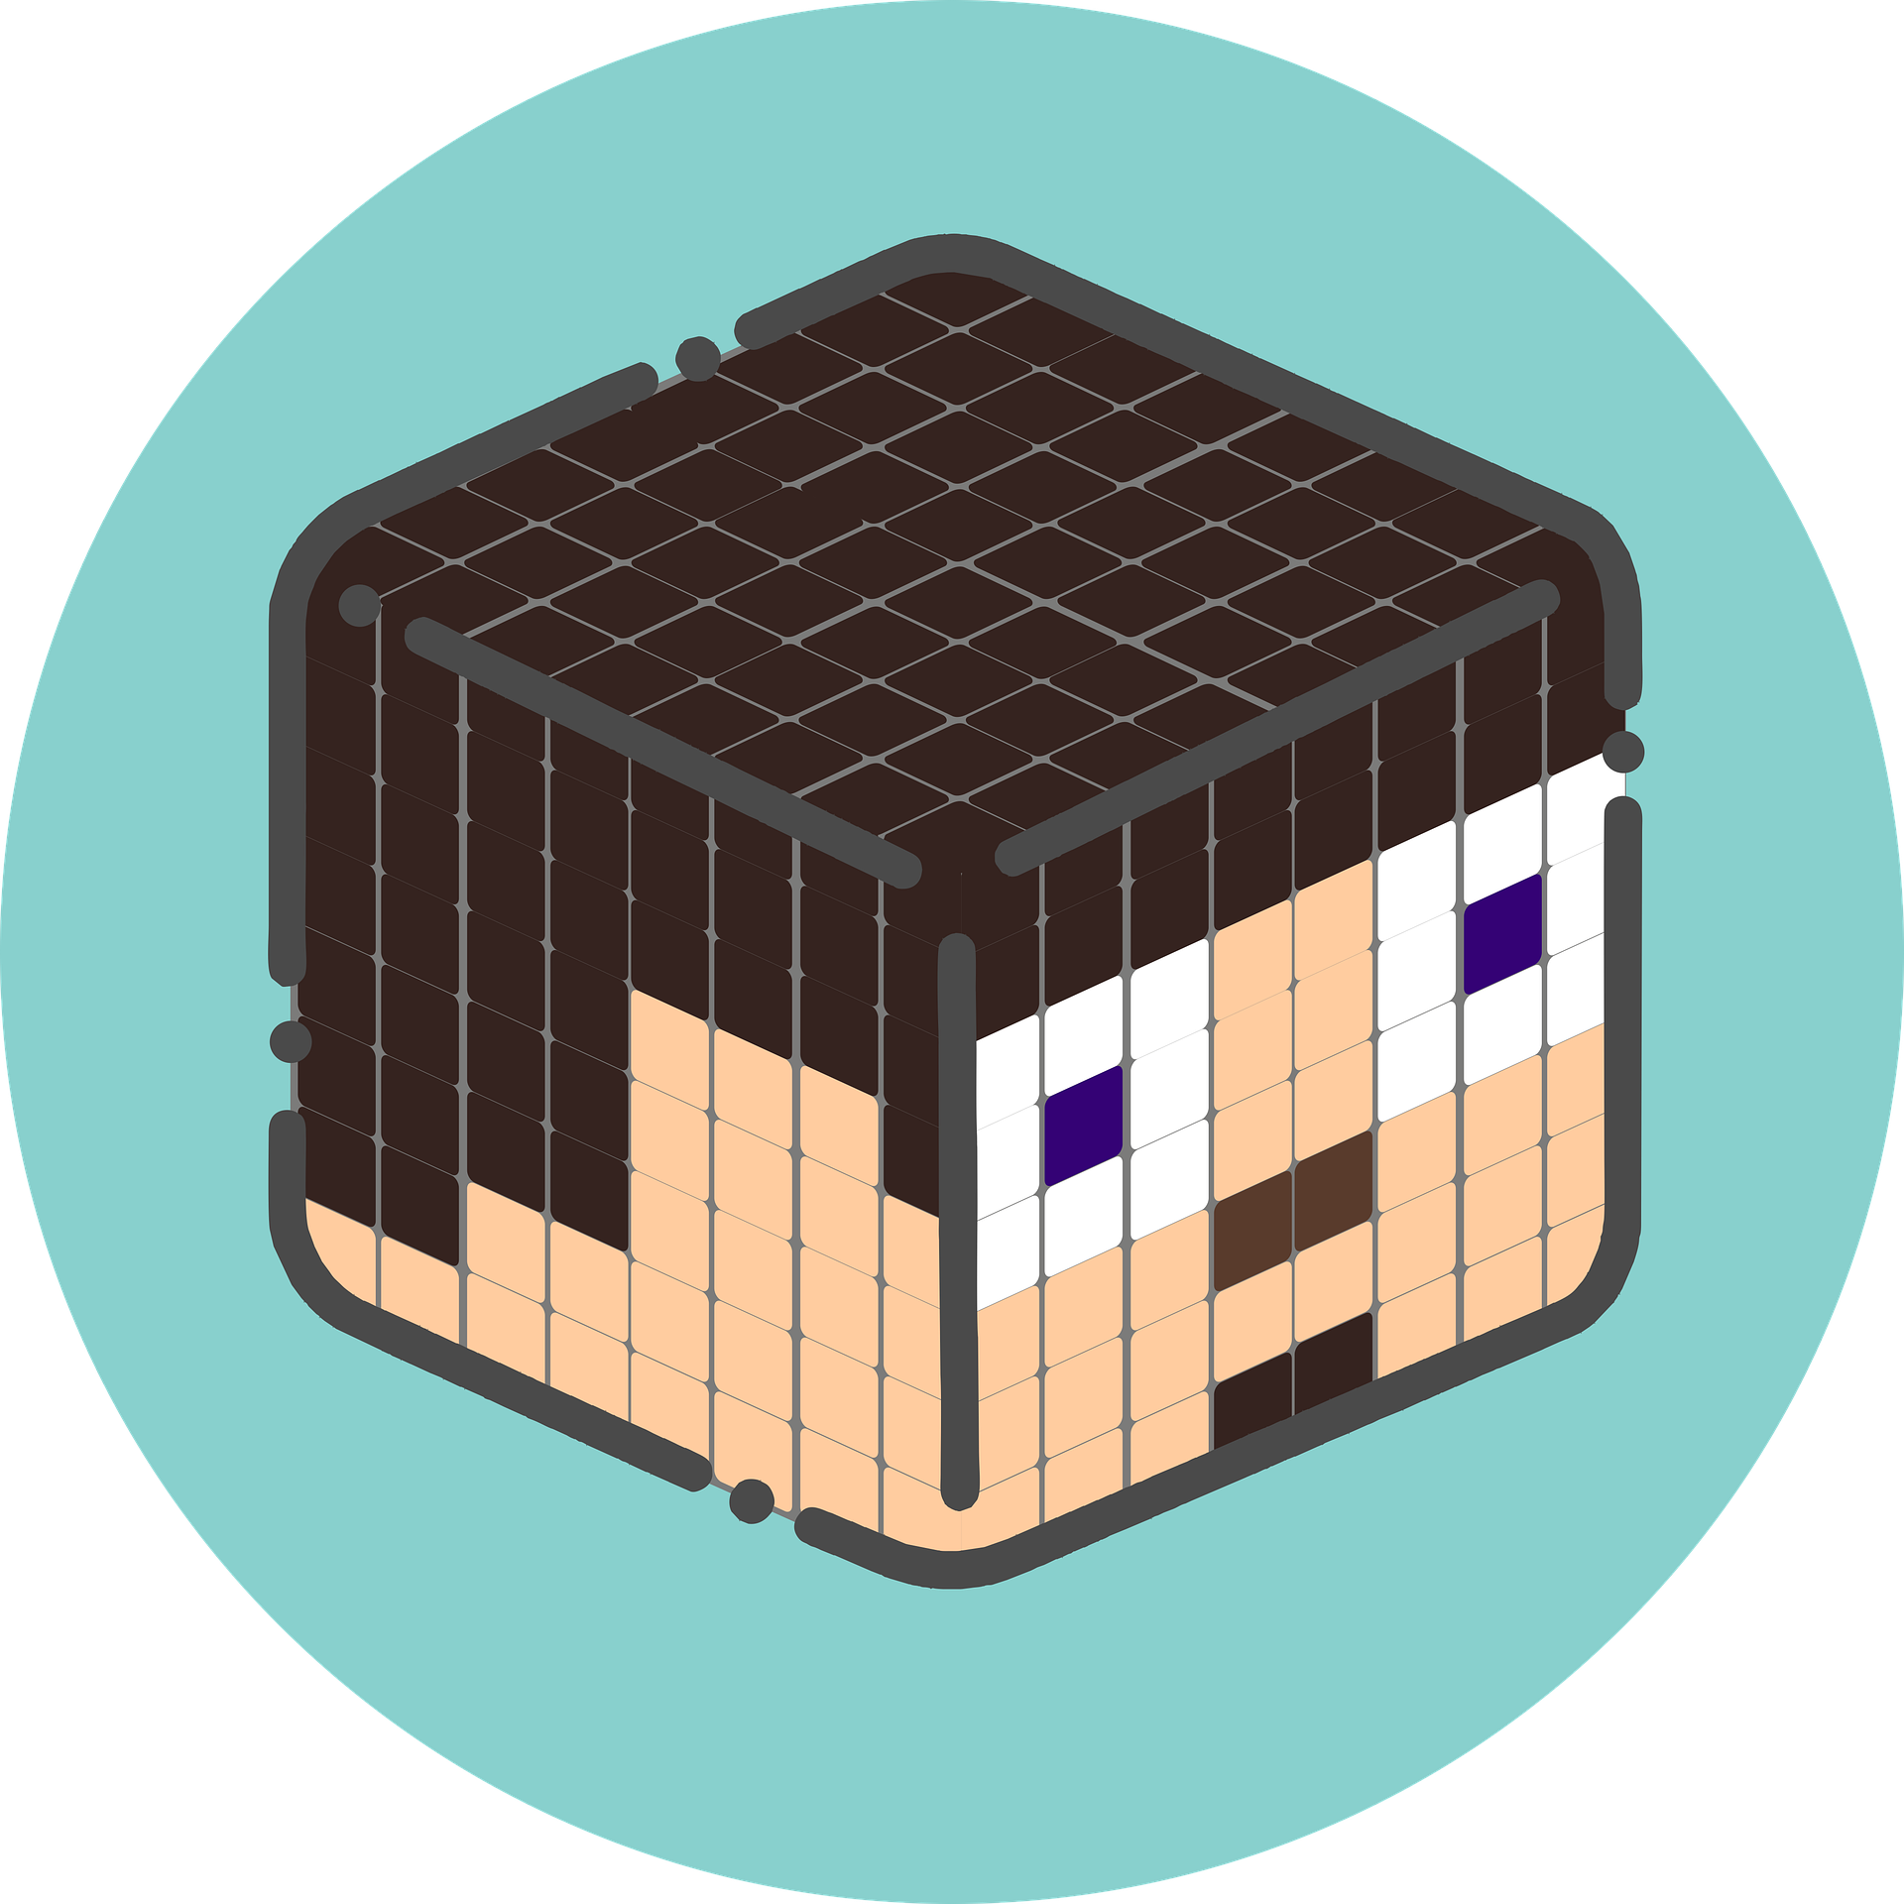
MINECRAFT
Goal Tracker
Hooray! You did it!
100
80
60
40
20

Slide 2
MINECRAFT
Goal Tracker
Hooray! You did it!
100
80
60
40
20

Slide 3
MINECRAFT
Goal Tracker
Hooray! You did it!
100
80
60
40
20

Slide 4
MINECRAFT
Goal Tracker
Hooray! You did it!
100
80
60
40
20

Slide 5
MINECRAFT
Goal Tracker
Hooray! You did it!
100
80
60
40
20

Slide 6
MINECRAFT
Goal Tracker
Hooray! You did it!
100
80
60
40
20

