Slide 1
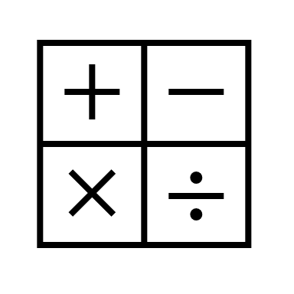
Math Practice Fun

Slide 2
Math Practice Fun
3+4
2+3
8+3
7+2
3+7
5+2
6+3
2+1
4+5
6+4
2+2
3+1
2+4
4+4
3+5
8+2
5+1
6+2
7+3
3+3
4+6
4+3
1+3
3+2
5+3
2+5
6+1
7+2
6+5
7+1
2+6
1+4
4+7
3+6
7+9
7+8
4+1
3+8
5+4
1+5
6+6
2+7
4+8
1+6
2+8
3+9
4+2
5+5
6+7
5+9
2+9
7+6
1+7
5+7
8+1
9+1
8+4
5+6
4+9
7+5
1+8
6+8
9+3
8+5
1+9
6+9
8+7
5+8
7+4
8+6

Slide 3
Math Practice Fun
3x4
2x3
8x3
7x2
3x7
5x2
6x3
2x1
4x5
6x4
2x2
3x1
2x4
4x4
3x5
8x2
5x1
6x2
7x3
3x3
4x6
4x3
1x3
3x2
5x3
2x5
6x1
7x2
6x5
7x1
2x6
1x4
4x7
3x6
7x9
7x8
4x1
3x8
5x4
1x5
6x6
2x7
4x8
1x6
2x8
3x9
4x2
5x5
6x7
5x9
2x9
7x6
1x7
5x7
8x1
9x1
8x4
5x6
4x9
7x5
1x8
6x8
9x3
8x5
1x9
6x9
8x7
5x8
7x4
8x6

